Slide 1
Classification using Logistic Regression
Dataset used: Wisconsin Breast Cancer Dataset
Task: To predict whether the breast cancer malignant or benign tumor

Slide 2
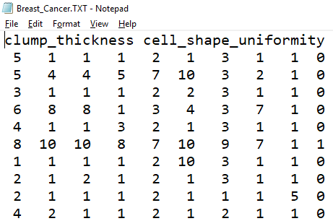
A Quick view of the Dataset
Collected by Dr. William H. Wohlberg from the University of Wisconsin Hospitals, Madison.
699 rows & 10 columns:
Clump Thickness
Uniformity of Cell Size
Uniformity of Cell Shape
Marginal Adhesion
Single Epithelial Cell Size
Bare Nuclei
Bland Chromatin
Normal Nucleoli
Mitoses
Class (Response Variable)

Slide 3
Problem Statement & Task
A tumor is an abnormal lump or growth of cells.
When the cells in the tumor are normal, it is benign.
When the cells are abnormal and can grow uncontrollably, they are cancerous cells, and the tumor is malignant.
Nine predictors are used to predict the class of cancer.
Logistic Regression algorithm is used, since it is a binary classification problem.

Slide 4
Task Breakdown: CRISP-DM Model
Cross Industry Standard Process for Data Mining (CRISP-DM)
First phase - Business Understanding
Second phase - Data Understanding
Third phase - Data Preparation
Fourth phase - Modeling
Fifth phase - Evaluation
Sixth phase - Deployment

Slide 5
Business Statement & Benefits
Breast Cancer diagnosis is very necessary.
Most general hospitals do not have the facilities.
Cancer can spread if long time is taken to diagnose.
Malignant & Benign tumors are very hard to distinguish.
Early Discovery: Lots of saved lives.

Slide 6
Requirements:
Operating System: Windows 10
Anaconda Distribution for Windows
Jupyter Notebook
Python Version 3.5.6
Python3 libraries: numpy, pandas, matplotlib, seaborn, scikit-learn, and statsmodels
Wisconsin Breast Cancer Dataset

Slide 7
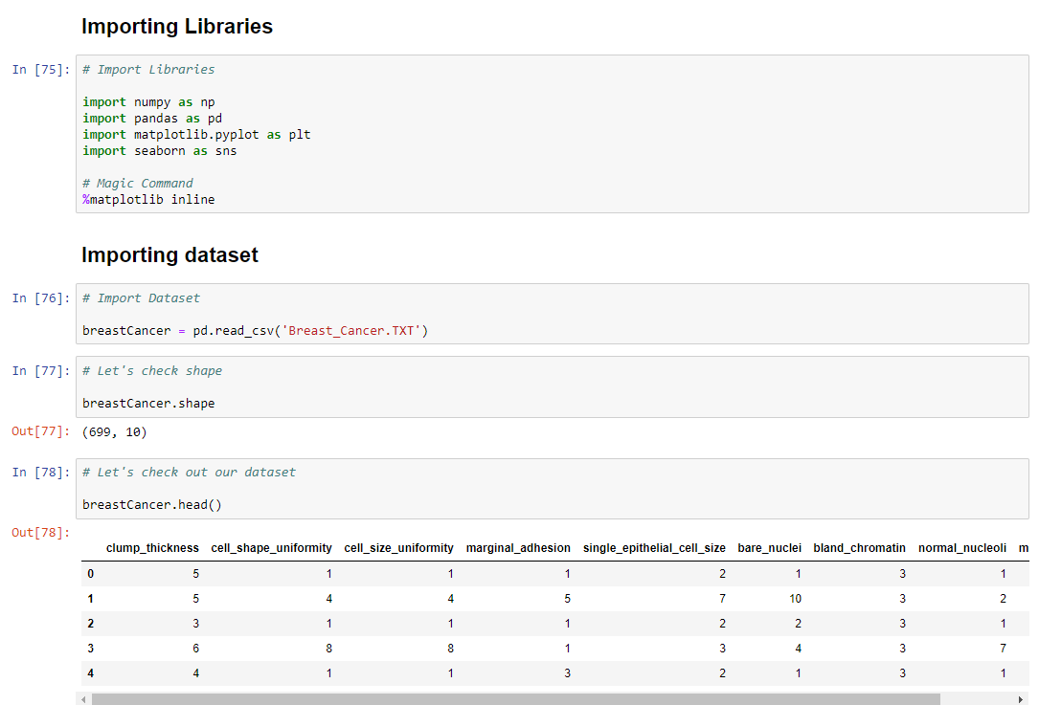
Pre - requisites

Slide 8
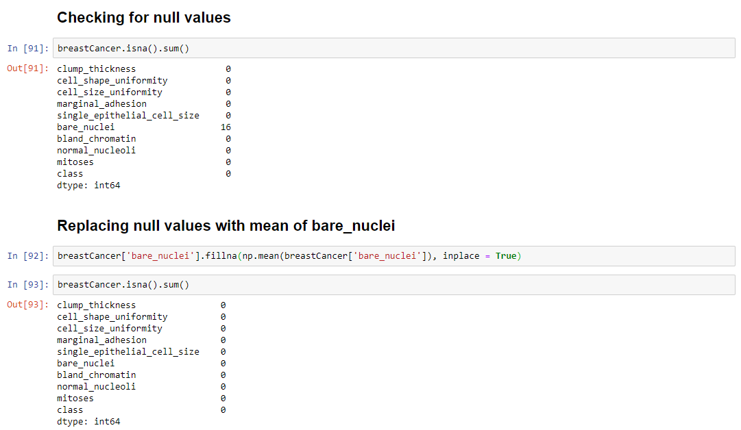
Cleaning the dataset

Slide 9
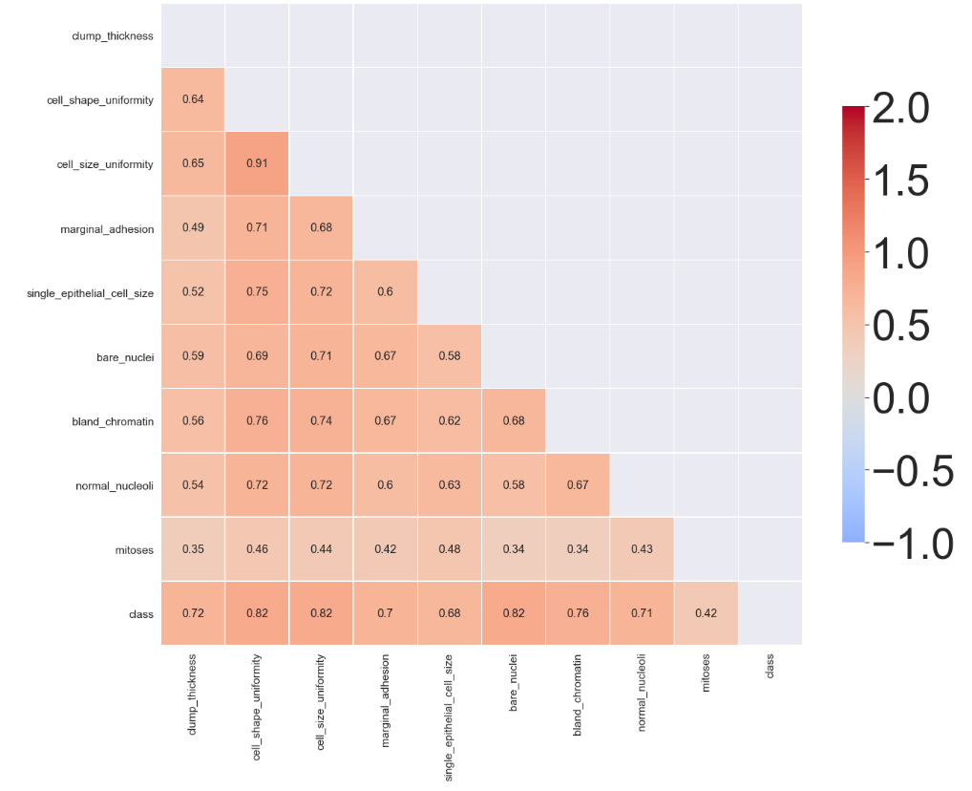
Exploratory Data Analysis

Slide 10
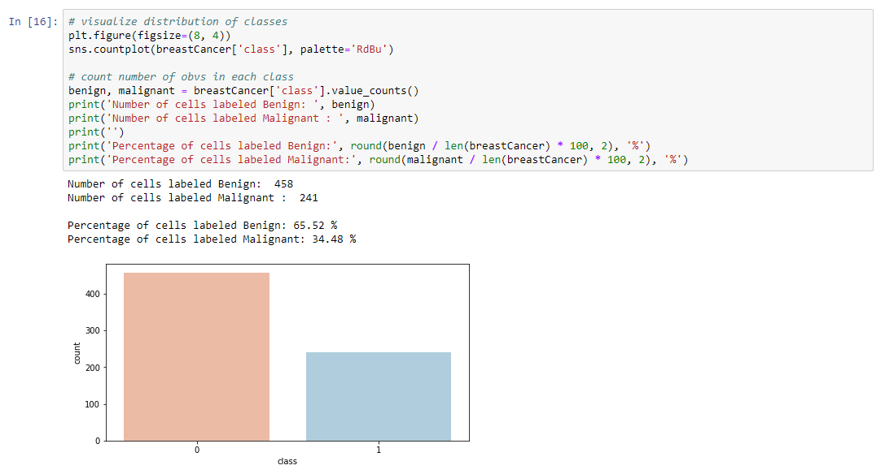
Exploratory Data Analysis

Slide 11
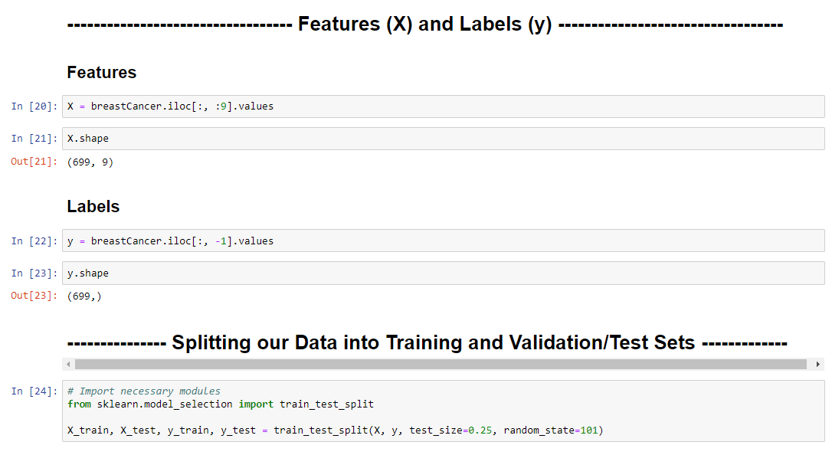
Ques. 1
Build a logistic regression model with "class" as the response variable, and all other remaining variables as the predictors.

Slide 12
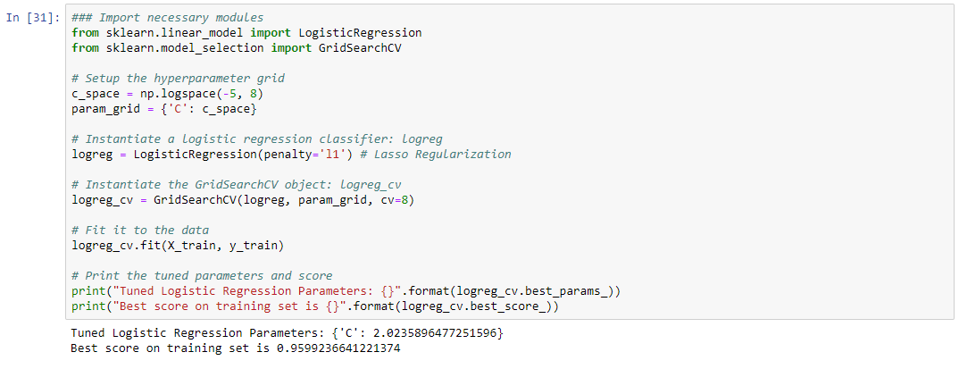
Fitting Model

Slide 13
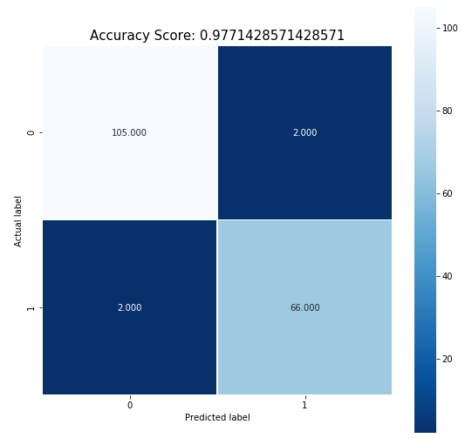
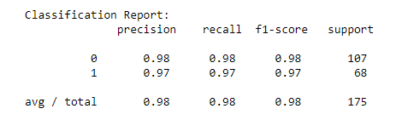
Evaluating Model on test data

Slide 14
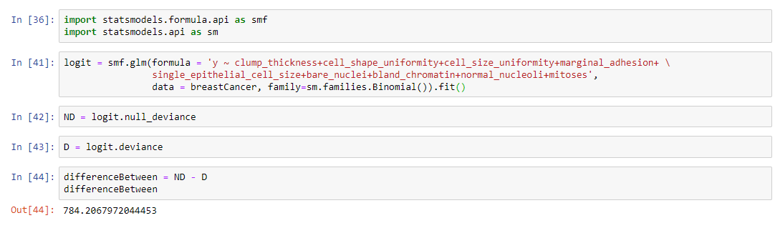
Ques. 2
What is the value of the deviance difference? Is the overall logistic regression significant? Explain your answer. What does it mean to say that the overall logistic regression is significant?

Slide 15
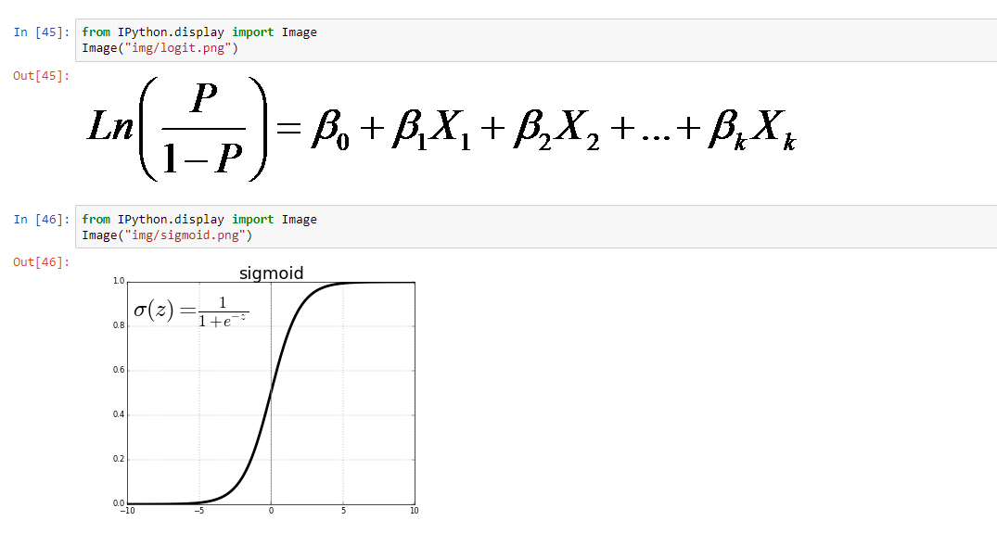
Ques. 3
Without reference to inferential significance, express the form of the logit.

Slide 16

Ques. 4
Which variables do not appear to be significant predictors of breast cancer tumor class? Explain your answer.
Backward Elimination
x4 i.e marginal_adhesion is insignificant
After 2 iterations,
x3 i.e cell_size_uniformity is also insignificant
All other variables are significant

Slide 17
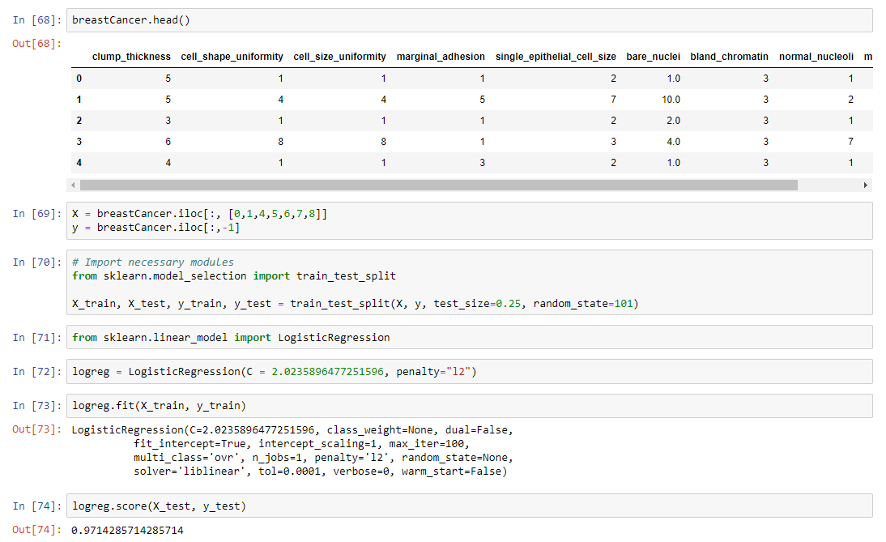
Ques. 5
Discuss whether the variables you cited in Question number 4 above, should be used in predicting the class of tumor with a new unseen data set.

Slide 18
Ques. 6
Discuss how you should handle variables with p-values around 0.05, 0.10 or 0.15.
The significance level for a given hypothesis test is a value for which a p-value less than or equal to is considered statistically significant. Typical values for are 0.05, 0.10, and 0.15.
The p-value is compared with the desired significance level of our test and, if it smaller, the result is significant. If p-value is greater than significant level we remove that features from our training data.
We will find p-value for each feature and then we compare each p-value with desired significance level.
If p-value is less than or equal to significance level it means the particular feature is significant, and we remove all those features with p-value greater than significance level.

Slide 19
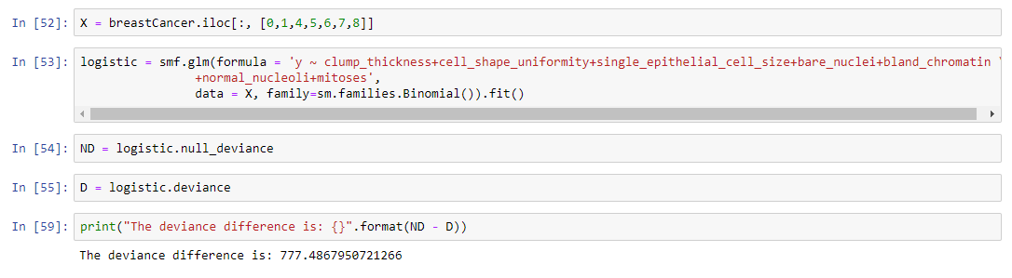
Ques. 7
Explain what will happen to the deviance difference if you rerun the model, dropping the non-significant variables.

Slide 20
Thank You.

